Slide 1
Character Navigation
Robert Stautz
Notes:
These are notes.

Slide 2
Overview
Briefly review the A* algorithm.
Some variations to A*.
Dynamic Pathfinding

Slide 3
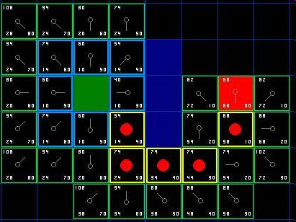
A*
Best-First graph search
Uses a heuristic to determine paths more likely to lead to the goal
G(n) = distance from start to current
H(n) = dist from current to goal
F(n) = G(n) + H(n)

Slide 4
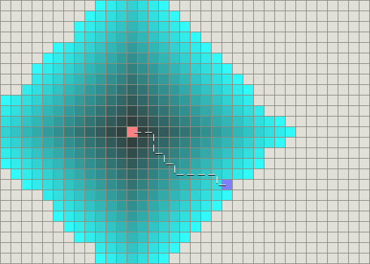
Dijkstra’s Algorithm
Briefly introduced in CS310.
Starts with the closest verticies and expands outwards.
Guaranteed to find a shortest path. Why is this bad?

Slide 5
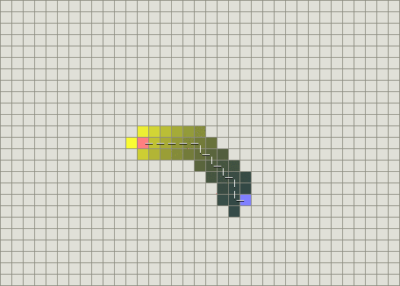
Greedy BFS
Not guaranteed to find a shortest path.
Uses a heuristic shown in yellow.
Computed cost to get to the goal from the current node.
Benefits?

Slide 6
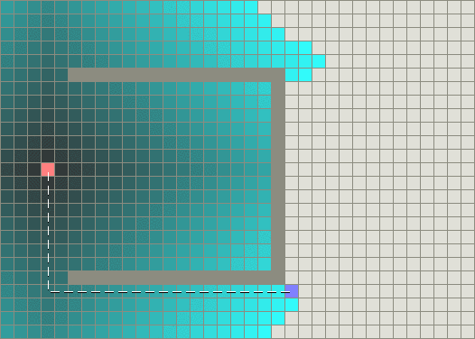
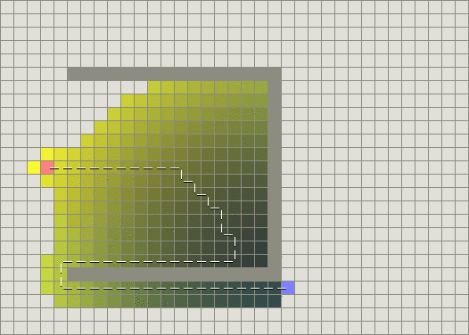
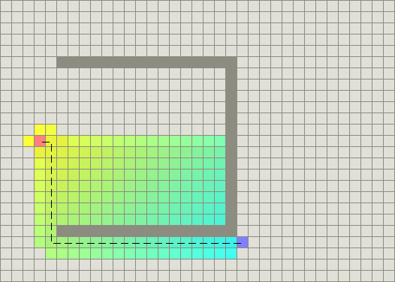
Dijkstra’s Algorithm
Greedy
A* Algorithm
Next: A* Variations
Dynamic Weights

Slide 7
Dynamic weighting
F(n) = g(n) + w(n) * h(n)
w >= 1, as you get closer to the goal, decrease this weight.
Assume that at the beginning of your search it is more important to start moving.
Near the end of the search priority goes to getting to the goal.
Next: Beam Search

Slide 8
Beam Search
Places a limit on the size of the open set.
Once the open set is full the worst node is dropped.
Pro’s: Cuts back on the amount of memory for large searches.
Con’s: You need to keep the set sorted which limits the types of data structures you can use.

Slide 9
Problems with all of this is that it gives the NPC’s complete information and control.
What about when we limit the NPC’s knowledge of the surrounding area?

Slide 10
Dynamic A*
Used when the entire map is unknown.
Initially assume the environment is empty.
When an obstacle is registered replan the path.
Used in robotics and maze navigation.

Slide 11
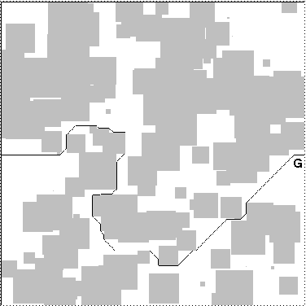
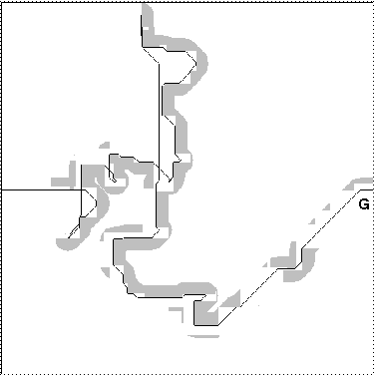
D*
The first picture shows A* running and the shortest path
The second picture shows D* and how it would navigate through the environment.
Obviously does not come up with a shortest path, but if a path exists, it will find it.

Slide 12
PacMan
Mason.jar A PacMan game courtesy of Prof. Sean Luke.
Ghosts using a Greedy search

Slide 13
Summary
There are a lot of slight variations you can do to increase speed or performance.
A* isn’t the only option.
Decide how important is a shortest path to your character’s navigation.

Slide 14
Sources…
Tony Stentz, Research Professor at Carnegie Mellon Uni. http://www.frc.ri.cmu.edu/~axs/dynamic_plan.html
Amit Patel, Ph.D. student at Stanford University http://theory.stanford.edu/~amitp/GameProgramming/
Jamey Pittman, Game Programmer and PackMan fan http://home.comcast.net/~jpittman2/pacman/pacmandossier.html

